Slide 1
Chapter 21: Information Retrieval

Slide 2
Chapter 21: Information Retrieval
Relevance Ranking Using Terms
Relevance Using Hyperlinks
Synonyms., Homonyms, and Ontologies
Indexing of Documents
Measuring Retrieval Effectiveness
Web Search Engines
Information Retrieval and Structured Data
Directories

Slide 3
Information Retrieval Systems
Information retrieval (IR) systems use a simpler data model than database systems
Information organized as a collection of documents
Documents are unstructured, no schema
Information retrieval locates relevant documents, on the basis of user input such as keywords or example documents
e.g., find documents containing the words “database systems”
Can be used even on textual descriptions provided with non-textual data such as images
Web search engines are the most familiar example of IR systems

Slide 4
Information Retrieval Systems (Cont.)
Differences from database systems
IR systems don’t deal with transactional updates (including concurrency control and recovery)
Database systems deal with structured data, with schemas that define the data organization
IR systems deal with some querying issues not generally addressed by database systems
Approximate searching by keywords
Ranking of retrieved answers by estimated degree of relevance

Slide 5
Keyword Search
In full text retrieval, all the words in each document are considered to be keywords.
We use the word term to refer to the words in a document
Information-retrieval systems typically allow query expressions formed using keywords and the logical connectives and, or, and not
Ands are implicit, even if not explicitly specified
Ranking of documents on the basis of estimated relevance to a query is critical
Relevance ranking is based on factors such as
Term frequency
Frequency of occurrence of query keyword in document
Inverse document frequency
How many documents the query keyword occurs in
Fewer ➔ give more importance to keyword
Hyperlinks to documents
More links to a document ➔ document is more important

Slide 6
Relevance Ranking Using Terms
n(d, t)
TF (d, t) = log
1 +
n(d)
∑
TF (d, t)
r (d, Q) =
t∈Q
n(t)
TF-IDF (Term frequency/Inverse Document frequency) ranking:
Let n(d) = number of terms in the document d
n(d, t) = number of occurrences of term t in the document d.
Relevance of a document d to a term t
The log factor is to avoid excessive weight to frequent terms
Relevance of document to query Q

Slide 7
Relevance Ranking Using Terms (Cont.)
Most systems add to the above model
Words that occur in title, author list, section headings, etc. are given greater importance
Words whose first occurrence is late in the document are given lower importance
Very common words such as “a”, “an”, “the”, “it” etc. are eliminated
Called stop words
Proximity: if keywords in query occur close together in the document, the document has higher importance than if they occur far apart
Documents are returned in decreasing order of relevance score
Usually only top few documents are returned, not all

Slide 8
Similarity Based Retrieval
Similarity based retrieval - retrieve documents similar to a given document
Similarity may be defined on the basis of common words
E.g., find k terms in A with highest TF (d, t ) / n (t ) and use these terms to find relevance of other documents.
Relevance feedback: Similarity can be used to refine answer set to keyword query
User selects a few relevant documents from those retrieved by keyword query, and system finds other documents similar to these
Vector space model: define an n-dimensional space, where n is the number of words in the document set.
Vector for document d goes from origin to a point whose i ^{th} coordinate is TF (d,t ) / n (t )
The cosine of the angle between the vectors of two documents is used as a measure of their similarity.

Slide 9
Relevance Using Hyperlinks
Number of documents relevant to a query can be enormous if only term frequencies are taken into account
Using term frequencies makes “spamming” easy
E.g., a travel agency can add many occurrences of the words “travel” to its page to make its rank very high
Most of the time people are looking for pages from popular sites
Idea: use popularity of Web site (e.g., how many people visit it) to rank site pages that match given keywords
Problem: hard to find actual popularity of site
Solution: next slide

Slide 10
Relevance Using Hyperlinks (Cont.)
Solution: use number of hyperlinks to a site as a measure of the popularity or prestige of the site
Count only one hyperlink from each site (why? - see previous slide)
Popularity measure is for site, not for individual page
But, most hyperlinks are to root of site
Also, concept of “site” difficult to define since a URL prefix like cs.yale.edu contains many unrelated pages of varying popularity
Refinements
When computing prestige based on links to a site, give more weight to links from sites that themselves have higher prestige
Definition is circular
Set up and solve system of simultaneous linear equations
Above idea is basis of the Google PageRank ranking mechanism

Slide 11
Relevance Using Hyperlinks (Cont.)
Connections to social networking theories that ranked prestige of people
E.g., the president of the U.S.A has a high prestige since many people know him
Someone known by multiple prestigious people has high prestige
Hub and authority based ranking
A hub is a page that stores links to many pages (on a topic)
An authority is a page that contains actual information on a topic
Each page gets a hub prestige based on prestige of authorities that it points to
Each page gets an authority prestige based on prestige of hubs that point to it
Again, prestige definitions are cyclic, and can be got by solving linear equations
Use authority prestige when ranking answers to a query

Slide 12
Synonyms and Homonyms
Synonyms
E.g., document: “motorcycle repair”, query: “motorcycle maintenance”
Need to realize that “maintenance” and “repair” are synonyms
System can extend query as “motorcycle and (repair or maintenance)”
Homonyms
E.g., “object” has different meanings as noun/verb
Can disambiguate meanings (to some extent) from the context
Extending queries automatically using synonyms can be problematic
Need to understand intended meaning in order to infer synonyms
Or verify synonyms with user
Synonyms may have other meanings as well

Slide 13
Concept-Based Querying
Approach
For each word, determine the concept it represents from context
Use one or more ontologies:
Hierarchical structure showing relationship between concepts
E.g., the ISA relationship that we saw in the E-R model
This approach can be used to standardize terminology in a specific field
Ontologies can link multiple languages
Foundation of the Semantic Web (not covered here)

Slide 14
Indexing of Documents
An inverted index maps each keyword K_{i} to a set of documents S_{i} that contain the keyword
Documents identified by identifiers
Inverted index may record
Keyword locations within document to allow proximity based ranking
Counts of number of occurrences of keyword to compute TF
and operation: Finds documents that contain all of K₁, K₂, ..., K_{n}.
Intersection S₁∩ S₂ ∩..... ∩ S_{n}
or operation: documents that contain at least one of K₁, K₂, …, K_{n}
union, S₁∩ S₂ ∩..... ∩ S_{n},.
Each S_{i} is kept sorted to allow efficient intersection/union by merging
“not” can also be efficiently implemented by merging of sorted lists

Slide 15
Measuring Retrieval Effectiveness
Information-retrieval systems save space by using index structures that support only approximate retrieval. May result in:
false negative (false drop) - some relevant documents may not be retrieved.
false positive - some irrelevant documents may be retrieved.
For many applications a good index should not permit any false drops, but may permit a few false positives.
Relevant performance metrics:
precision - what percentage of the retrieved documents are relevant to the query.
recall - what percentage of the documents relevant to the query were retrieved.

Slide 16
Measuring Retrieval Effectiveness (Cont.)
Recall vs. precision tradeoff:
Can increase recall by retrieving many documents (down to a low level of relevance ranking), but many irrelevant documents would be fetched, reducing precision
Measures of retrieval effectiveness:
Recall as a function of number of documents fetched, or
Precision as a function of recall
Equivalently, as a function of number of documents fetched
E.g., “precision of 75% at recall of 50%, and 60% at a recall of 75%”
Problem: which documents are actually relevant, and which are not

Slide 17
Web Search Engines
Web crawlers are programs that locate and gather information on the Web
Recursively follow hyperlinks present in known documents, to find other documents
Starting from a seed set of documents
Fetched documents
Handed over to an indexing system
Can be discarded after indexing, or store as a cached copy
Crawling the entire Web would take a very large amount of time
Search engines typically cover only a part of the Web, not all of it
Take months to perform a single crawl

Slide 18
Web Crawling (Cont.)
Crawling is done by multiple processes on multiple machines, running in parallel
Set of links to be crawled stored in a database
New links found in crawled pages added to this set, to be crawled later
Indexing process also runs on multiple machines
Creates a new copy of index instead of modifying old index
Old index is used to answer queries
After a crawl is “completed” new index becomes “old” index
Multiple machines used to answer queries
Indices may be kept in memory
Queries may be routed to different machines for load balancing

Slide 19
Information Retrieval and Structured Data
Information retrieval systems originally treated documents as a collection of words
Information extraction systems infer structure from documents, e.g.:
Extraction of house attributes (size, address, number of bedrooms, etc.) from a text advertisement
Extraction of topic and people named from a new article
Relations or XML structures used to store extracted data
System seeks connections among data to answer queries
Question answering systems

Slide 20
Directories
Storing related documents together in a library facilitates browsing
Users can see not only requested document but also related ones.
Browsing is facilitated by classification system that organizes logically related documents together.
Organization is hierarchical: classification hierarchy

Slide 21
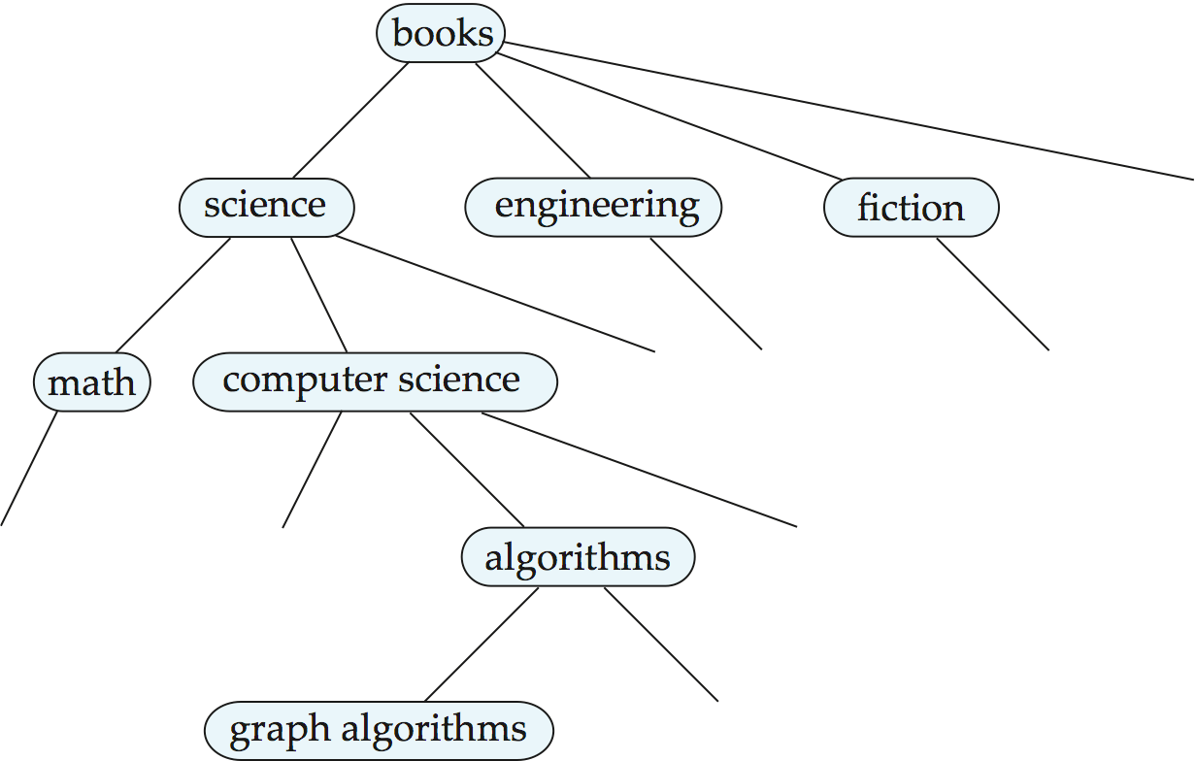
A Classification Hierarchy For A Library System

Slide 22
Classification DAG
Documents can reside in multiple places in a hierarchy in an information retrieval system, since physical location is not important.
Classification hierarchy is thus Directed Acyclic Graph (DAG)

Slide 23

A Classification DAG For A Library Information Retrieval System

Slide 24
Web Directories
A Web directory is just a classification directory on Web pages
E.g., Yahoo! Directory, Open Directory project
Issues:
What should the directory hierarchy be?
Given a document, which nodes of the directory are categories relevant to the document
Often done manually
Classification of documents into a hierarchy may be done based on term similarity

Slide 25
End of Chapter

